Slide 1


Advanced driver assistance system
Simon Sumanth 2010030343 Fauzaan Pasha 2010030452
Under the Guidance of
Dr. Shadab Siddiqui
Assistant Professor
Computer Science and Engineering Department
KL Hyderabad Off Campus, Aziz Nagar ,Hyderabad

Slide 2
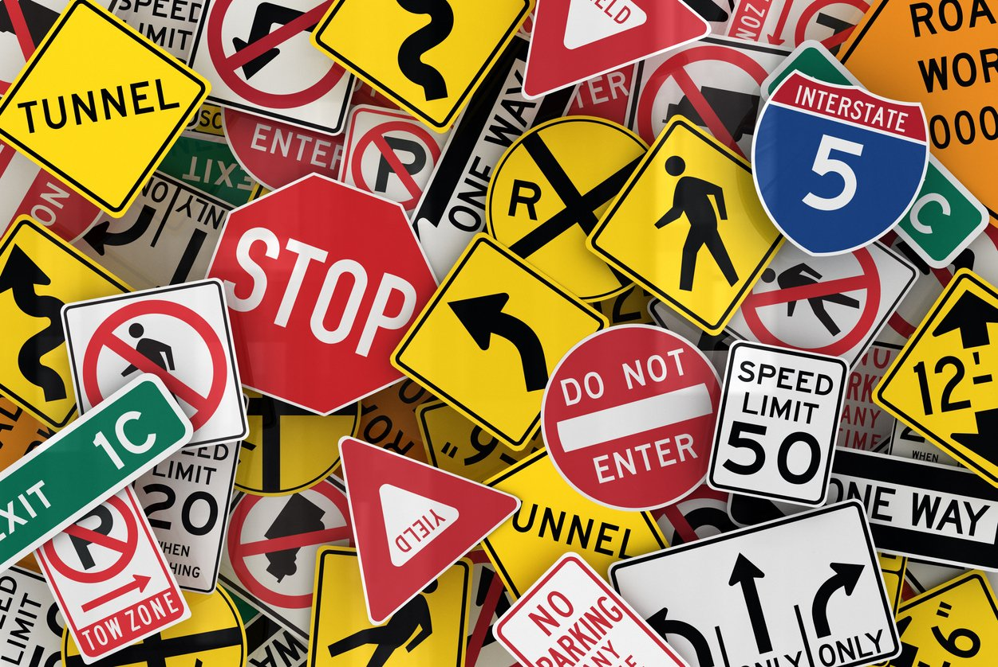
Overview
Introduction
Literature Review
Problem Statement
Objectives of the Project
Proposed Methodology
References

Slide 3

Introduction
Traffic signs play a crucial role in regulating and controlling traffic flow on roads, ensuring safety for drivers, pedestrians, and cyclists.
With the advent of computer vision and machine learning technologies, there has been a growing interest in developing automated systems for the recognition and classification of traffic signs.
Traffic sign classification involves the use of computer algorithms to identify and categorize different types of traffic signs based on visual information.
Traffic sign classification is a vital component in the development of intelligent transportation systems.

Slide 4
Literature Review
Traffic Sign Recognition using Deep Learning: A Review (2018) :
This review discusses various deep learning approaches, including CNNs, for traffic sign recognition. It covers the challenges and solutions in this domain and provides insights into the evolution of techniques.
Traffic Sign Recognition and Classification: A Survey (2019):
This survey explores different methodologies for traffic sign recognition, including traditional computer vision techniques and deep learning approaches. CNNs are discussed in the context of feature extraction and classification.
Comparative Study of CNN and RNN for Traffic Sign Recognition (2018):
This study compares the performance of CNNs and Recurrent Neural Networks (RNNs) for traffic sign recognition. It provides insights into the strengths and weaknesses of each architecture in this specific context.

Slide 5
Literature Review
"Traffic Sign Recognition - How far are we from the solution?" (2017):
Authors: Sermanet, P., LeCun, Y., & Chintala, S.
Published in: Neural Information Processing Systems (NeurIPS) conference.
This paper discusses the challenges in traffic sign recognition and proposes a deep learning approach using Convolutional Neural Networks (CNNs). It provides insights into the development and evaluation of a model on the GTSRB dataset.
"A Survey on Deep Learning Approaches for Traffic Sign Recognition" (2018):
Authors: Sengur, A.
Published in: Neural Computing and Applications.
This survey provides an overview of deep learning approaches, including CNNs, applied to traffic sign recognition. It covers various architectures, preprocessing techniques, and datasets used in the field.

Slide 6
Literature Review
"Traffic Sign Recognition: A Historical Perspective" (2019):
Authors: Houben, S., Stallkamp, J., Salmen, J., & Schlipsing, M.
Published in: Neural Networks.
The paper explores the historical evolution of traffic sign recognition systems, including traditional approaches and the shift towards deep learning. It also introduces the German Traffic Sign Recognition Benchmark (GTSRB) dataset.
"Deep Neural Networks for Traffic Sign Recognition in Advanced Driver Assistance Systems: A Review" (2020):
Authors: Khattak, A. M., Khan, M. U. K., & Kim, D. H.
Published in: Electronics.
This review focuses on the application of deep neural networks in advanced driver assistance systems, with an emphasis on traffic sign recognition. It covers various architectures, datasets, and challenges.

Slide 7
Literature Review
"Traffic Sign Recognition: A Benchmarking Study on the State of the Art" (2021):
Authors: Ronao, C. A., & Cho, S. B.
Published in: Expert Systems with Applications.
The paper provides a benchmarking study on the state-of-the-art in traffic sign recognition, evaluating multiple datasets and comparing the performance of different algorithms.
"Traffic Sign Recognition: An Overview and a Proposal of a Novel Algorithm" (2016):
Authors: Belgacem, F., Benmohammed, M.
Published in: IEEE Transactions on Intelligent Transportation Systems.
The paper presents an overview of traffic sign recognition and proposes a novel algorithm for efficient classification.

Slide 8

Problem Statement
The problem statement for traffic sign detection typically involves developing a computer vision system capable of identifying and recognizing traffic signs in images. The goal is to create a system that can assist in real-time traffic sign detection for applications such as autonomous vehicles even when they are moving in a lightning speed, advanced driver assistance systems (ADAS), or traffic monitoring.

Slide 9
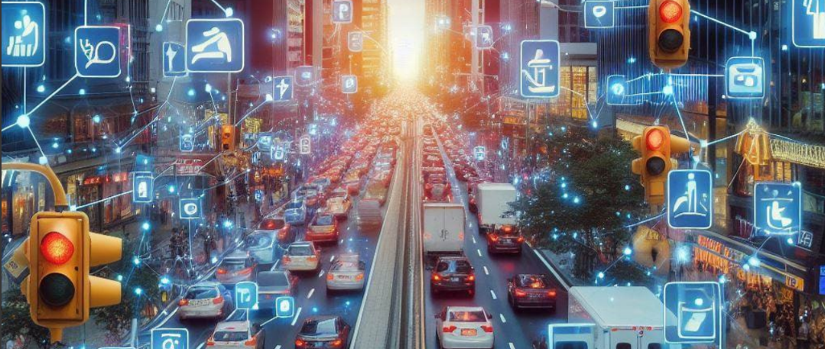
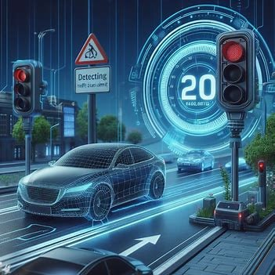
Objectives of the Project
Develop a Robust Deep Learning Model:
The primary objectives of traffic sign classification using machine learning are to automate the recognition and interpretation of traffic signs in images contributing to enhanced road safety and intelligent transportation systems.
Additionally, the objective is to enable real-time processing, ensuring quick and efficient recognition of signs and supporting time-sensitive decision-making.

Slide 10
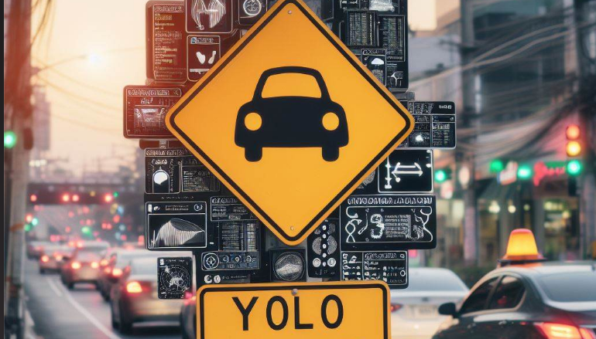
Proposed Methodology
Yolov8 :
Yolo, short for You Only Look Once, a popular object detection and image segmentation model.
It is the latest version of the acclaimed real-time object detection and image segmentation model. Based on cutting-edge advances in computer vision and deep learning, YOLOv8 provides unmatched speed and accuracy. Because of its simple architecture, it can be quickly adapted to a wide range of hardware platforms, including edge devices and cloud APIs, and is suited for a wide range of applications.

Slide 11
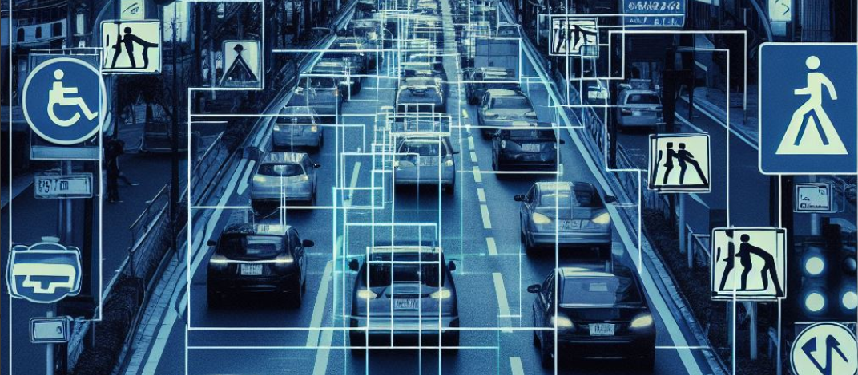
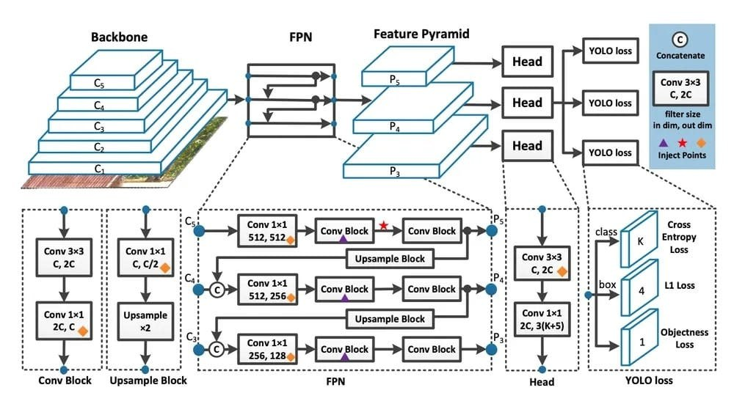
Architecture
Yolov8 :

Slide 12

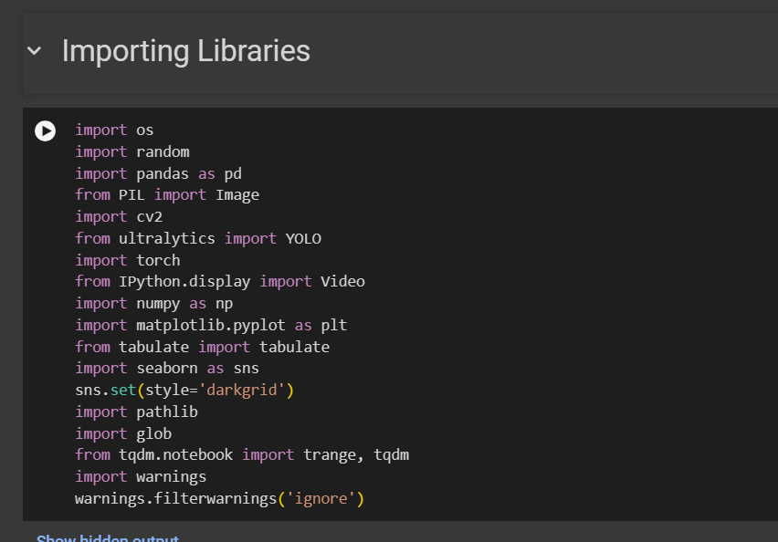
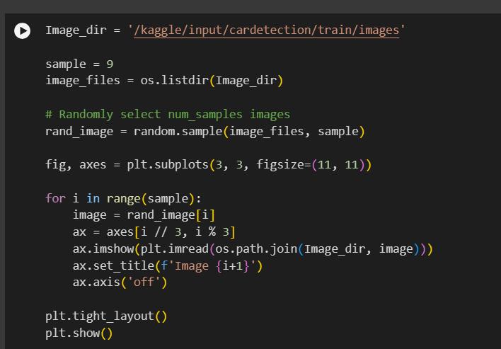
Code

Slide 13
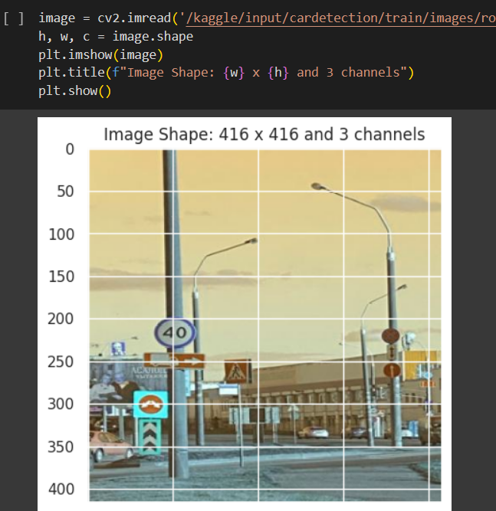
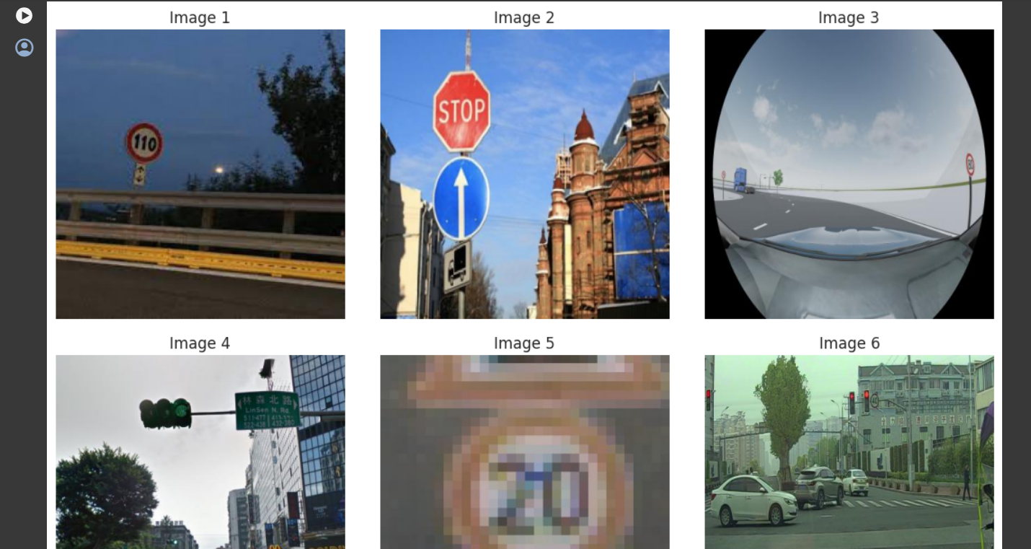
Code

Slide 14
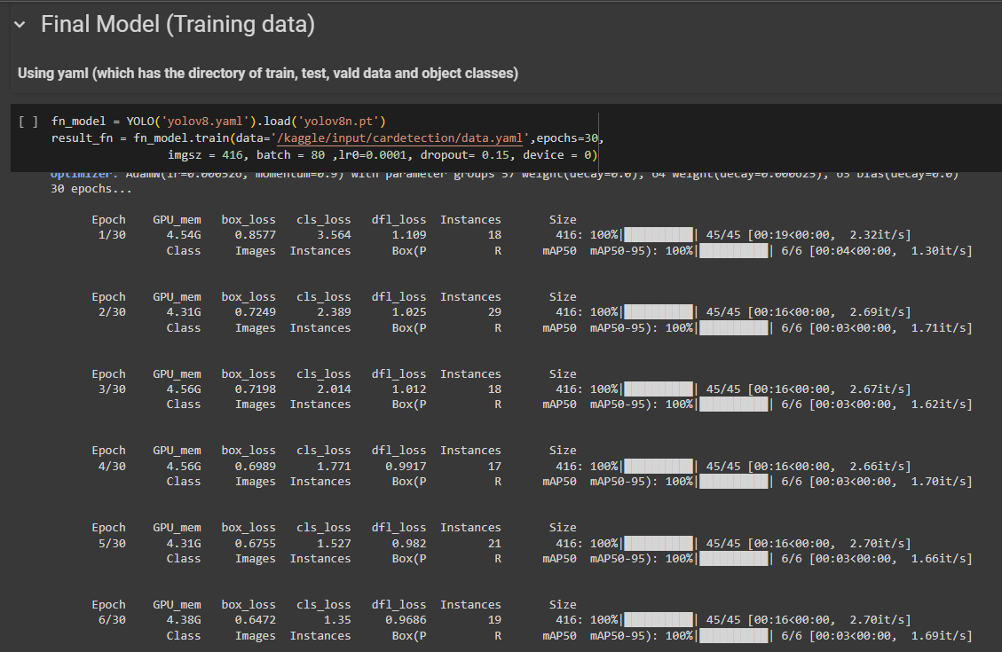
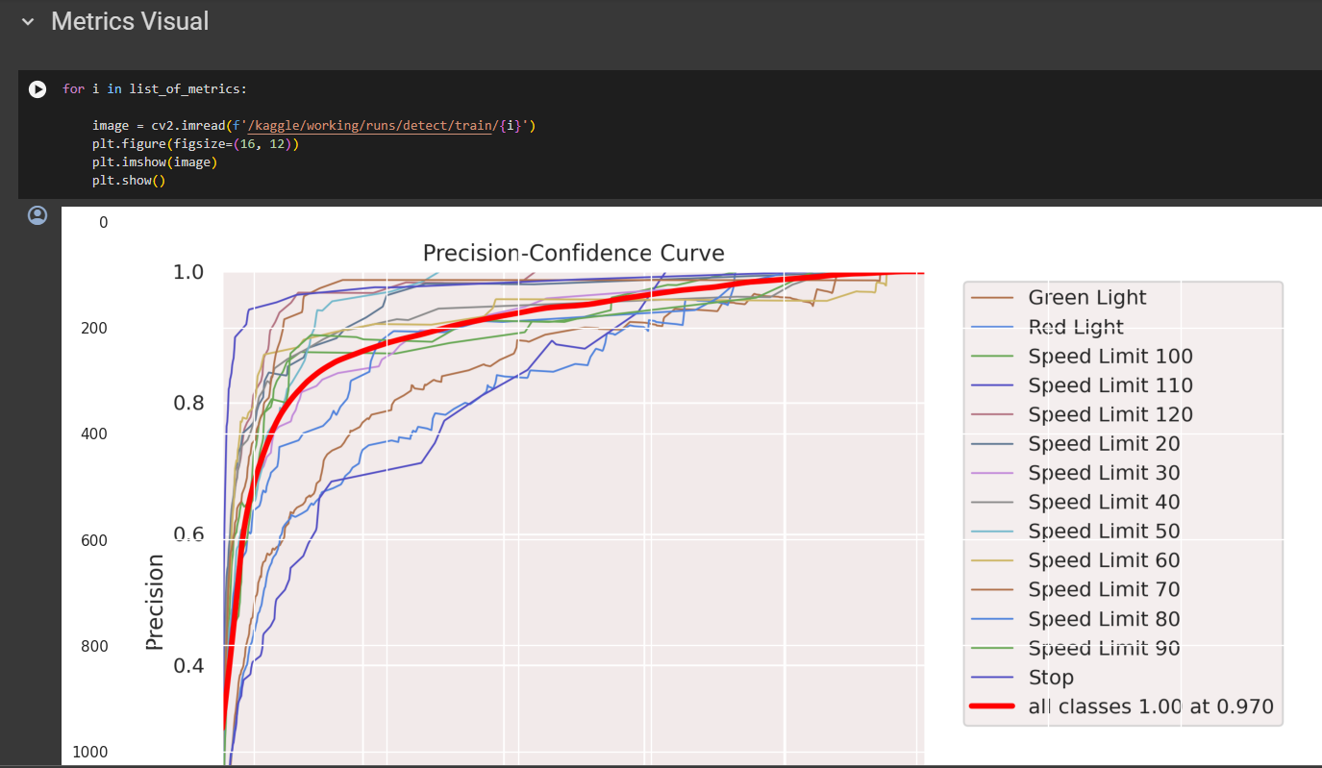
Code

Slide 15
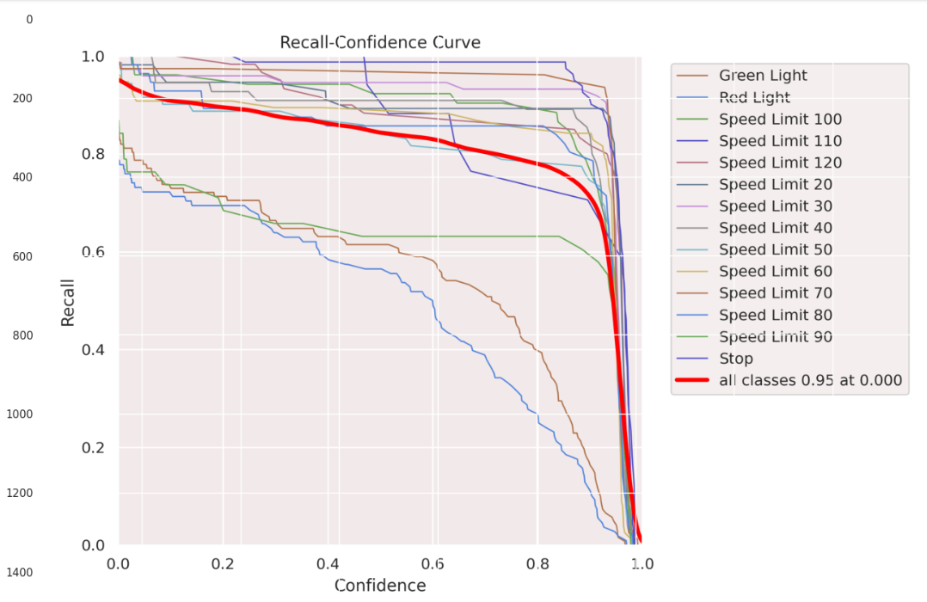
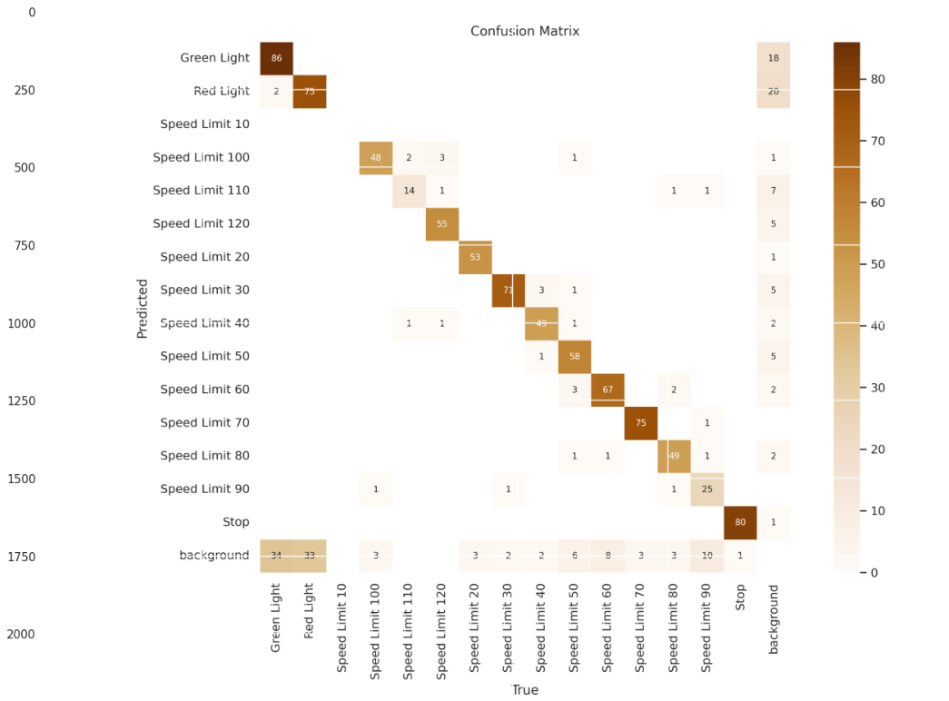
Code

Slide 16
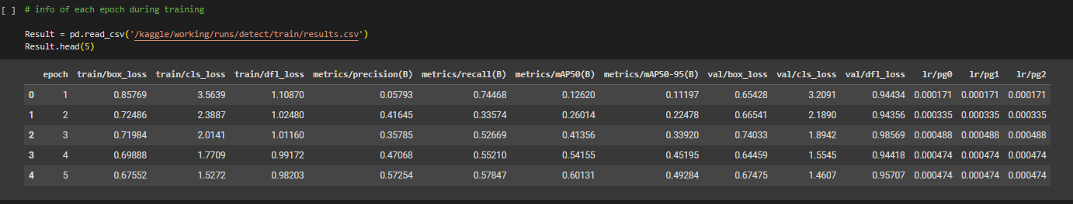
Code

Slide 17
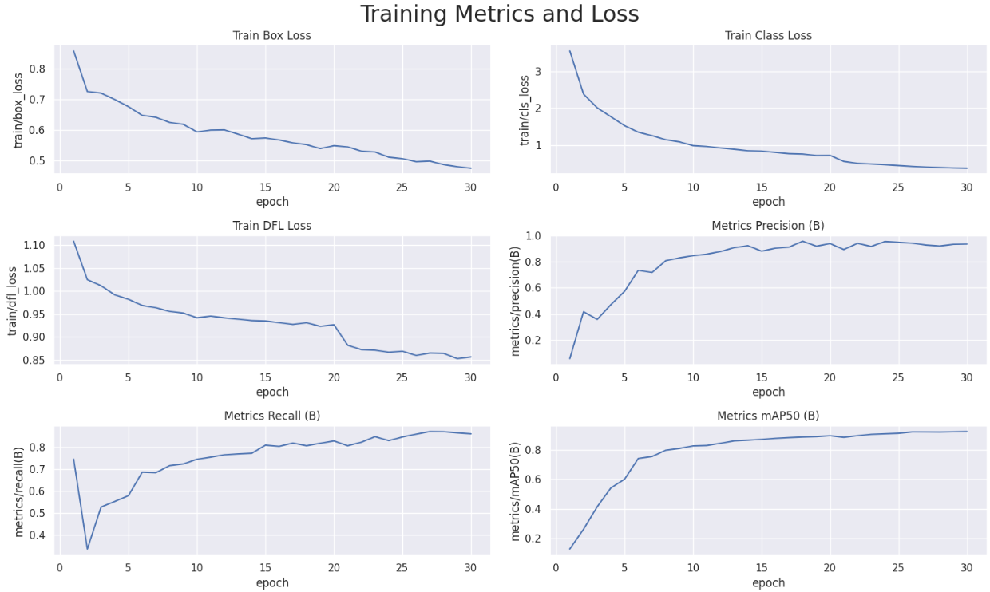
Code

Slide 18
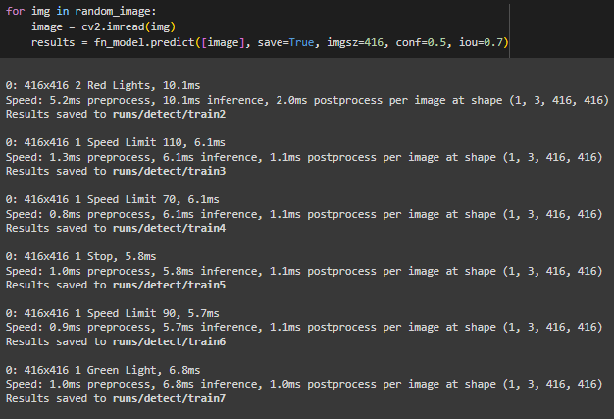
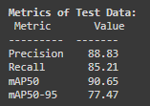
Code

Slide 19
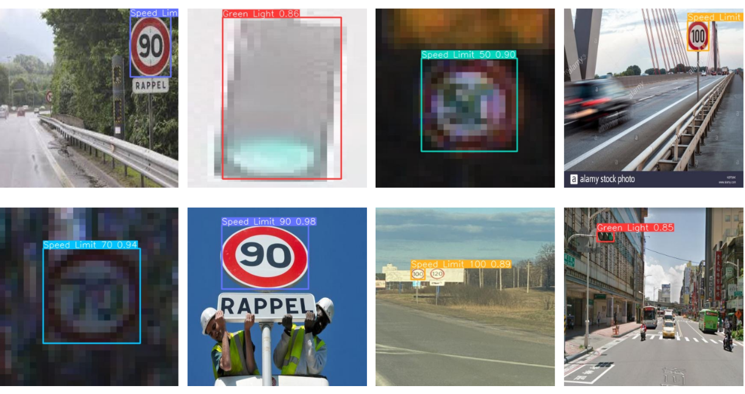
Output

Slide 20
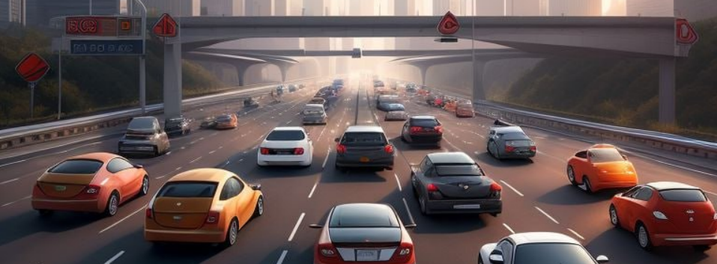
References
https://medium.com/@muhammadshabrozshahab/yolo-v8-104f1375242c#:~:text=YOLOv8%20works%20by%20first%20dividing,probabilities%20for%20each%20bounding%20box.
https://link.springer.com/article/10.1007/s11042-022-12163-0
https://www.e3s-conferences.org/articles/e3sconf/pdf/2021/05/e3sconf_iccsre2021_01006.pdf
https://ijcrt.org/papers/IJCRT2005338.pdf
https://www.kaggle.com/datasets/pkdarabi/cardetection/data

